Slide 1
CHARACTERIzation OF FRICTION STIR WELDed DISSIMILAR POLYMERic materials
Submitted by:
Name: m. siva durga teja
Bandla sai VISHAL
Suraj prasad

Slide 2
FRICTION STIR WELDING

Slide 3
INTRODUCTION
Welding using friction as a major resource
No filler material involved
Welds created by,
1.frictional heating
2.Mecanical deformation

Slide 4
History
Invented by TWI in 1991 in England
28 organizations worldwide use FSW

Slide 5
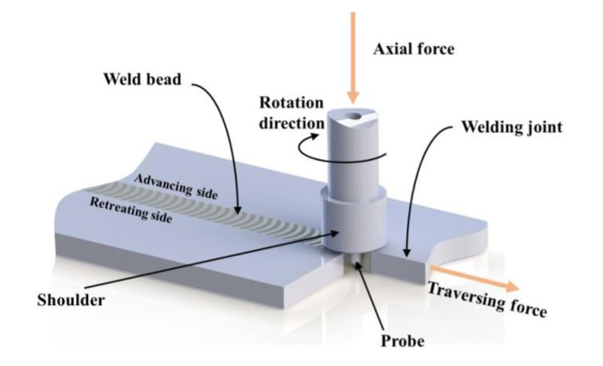
FRICTION STIR WELDING
Rotating probe provides friction heat and pressure which joins the material Sufficient downward force to maintain pressure and to create friction heat

Slide 6
Parameters required for fsw
FEED RATE OF TOOL
TEMPERTATURE OF SHOE
MAINTAIN RPM
FIXTURE
FRICTION STIR WELDING
DEPTH OF PENETRATION
MELTING POINT TEMPERATURE OF MATERIAL
TYPE OF JOINT
TIP OF TOOL

Slide 7
To optimize the process parameters of fsw
In Friction stir welding, process parameters are vital components that ensure the good quality of weld with better optimization
In FSW there are majorly three parameters. They are:1. Tool speed
2. Feed rate speed
3. Plunge in time

Slide 8
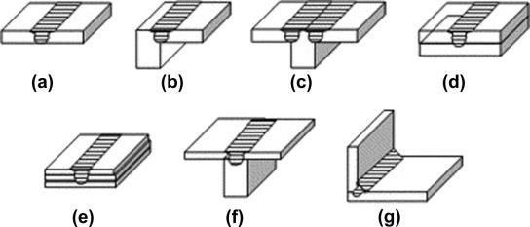
Welding positions
It can be welded in all positions.

Slide 9
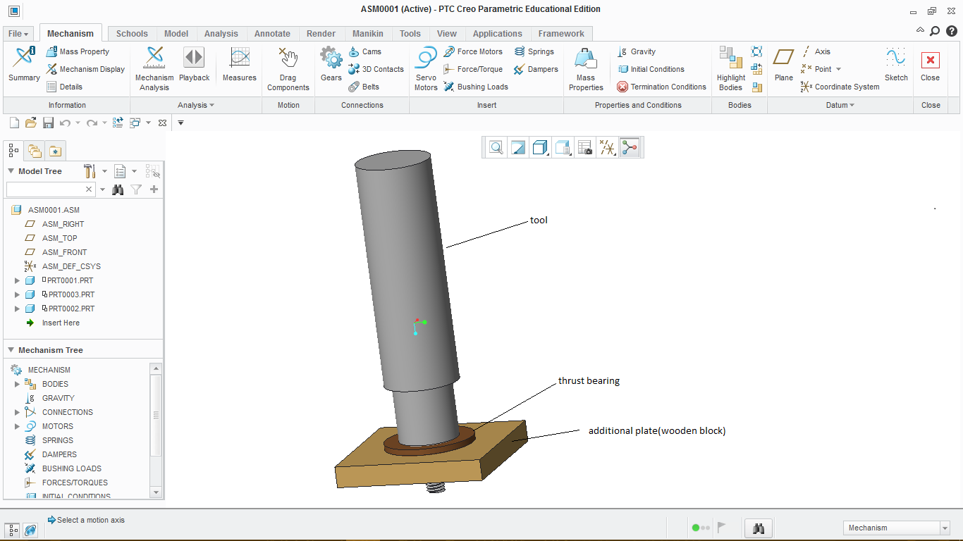
CAD MOdel
Tool dimensions
Tool material: low carbon Mild steel
Tool length:110 mm
Tool diameter:25 mm
Shoulder diameter: 20 mm
Pin diameter: 6 mm

Slide 10
Polymers
We selected polymers according to weldability chart and as per our availability
High Density polyethylene (HDPE)
Nylon-6, 6

Slide 11
Requirement for FSW
Special clamping system is necessary
Only for simple joint geometries (e.g. butt joint…)
Corrosion protection is needed (in case of metals)

Slide 12
ADVANTAGES of fsw
Fully automatic
Reduces energy consumption
Low environmental impact
Can operate in all position
It required little protection
It enhance the welding properties in mechanical as well as corrosion
It can be used in both similar and dissimilar materials
Easy to operate and does not involved in any environmental pollution
Lower power consumption due to absence of external heating

Slide 13
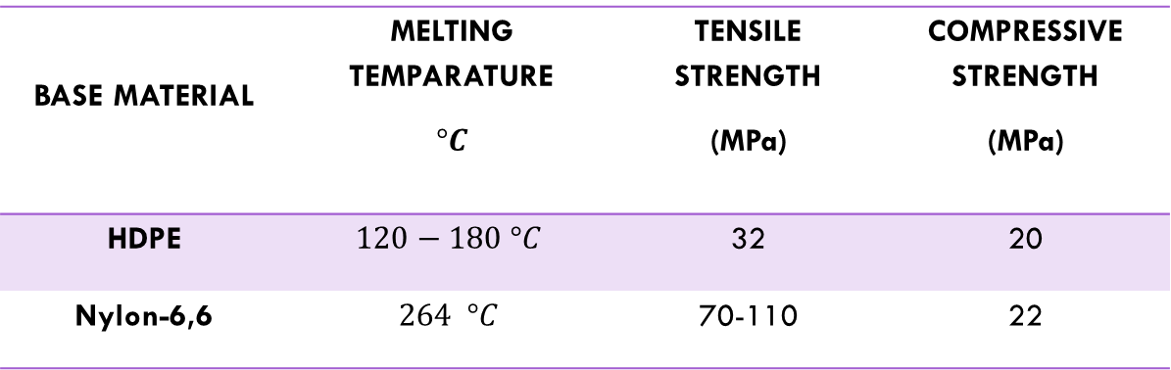
Material properties
BASE MATERIAL | MELTING TEMPARATURE $$°C$$ | TENSILE STRENGTH (MPa) | COMPRESSIVE STRENGTH (MPa)
HDPE | $$120−180 °C$$ | 32 | 20
Nylon-6,6 | $$264 °C$$ | 70-110 | 22

Slide 14
Cost of materials
BASE MATERIAL | DIMENSION OF MATERIAL |  | COST
 | THICKNESS | LENGTH*BREATH
HDPE | 5mm | 1m*1m | ₹ 1300.00
Nylon-6,6 | 6mm | 5.25*37.5 inch | ₹ 800.00
TOTAL COST |  |  | ₹ 2100.00

Slide 15
Flow chart for work procedure
Selection of materials
Purchase the selected materials according to our requirements
Design the tool geometry
Prepare tool as per design
Give program to CNC machine
Fix our tool to CNC milling machine
Arrange materials on fixture perfectly by using clamps
Cut the material at desire dimensions
Take that welded dissimilar materials and find weldability strength on testing machines
Operate CNC machine on work piece
Analysis on results

Slide 16
Design of experimentation
In design of experimentation, many combinations of process parameters are possible. Rather than making all possible combinations, it’s better to make less combinations with best results out of them. Taguchi L9 is one of the method with nine best combinations to give out better results than the performing whole possibilities.
Taguchi Method is a statistical approach to optimize the process parameters and improve the quality of components that are manufactured.
S. No. | Tool speed (rpm) A | Feed rate speed (mm/min) B | Plunge-in time (sec) C
1 | 1200 | 30 | 20
2 | 1200 | 40 | 40
3 | 1200 | 50 | 60
4 | 1400 | 30 | 40
5 | 1400 | 40 | 60
6 | 1400 | 50 | 20
7 | 1600 | 30 | 60
8 | 1600 | 40 | 20
9 | 1600 | 50 | 40

Slide 17
Work piece dimensions for fsw
For Tensile test
For Bending test
50 mm
10 mm
HDPE
HDPE
50 mm
50 mm
9 sample pieces and numbering from 1-9
Nylon-6,6
50 mm
50 mm
Nylon-6,6

Slide 18
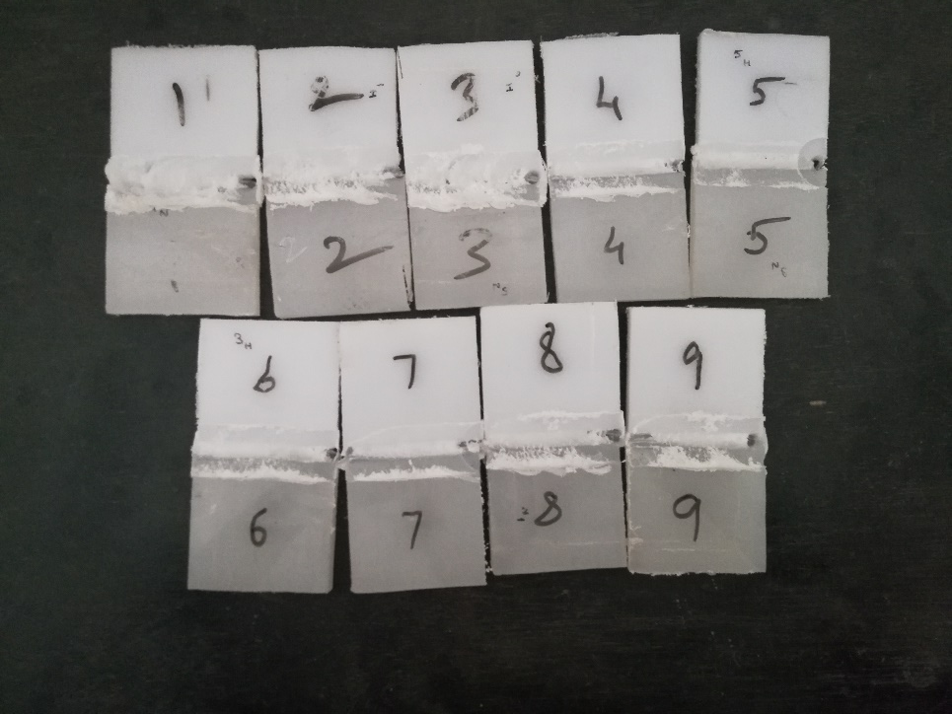
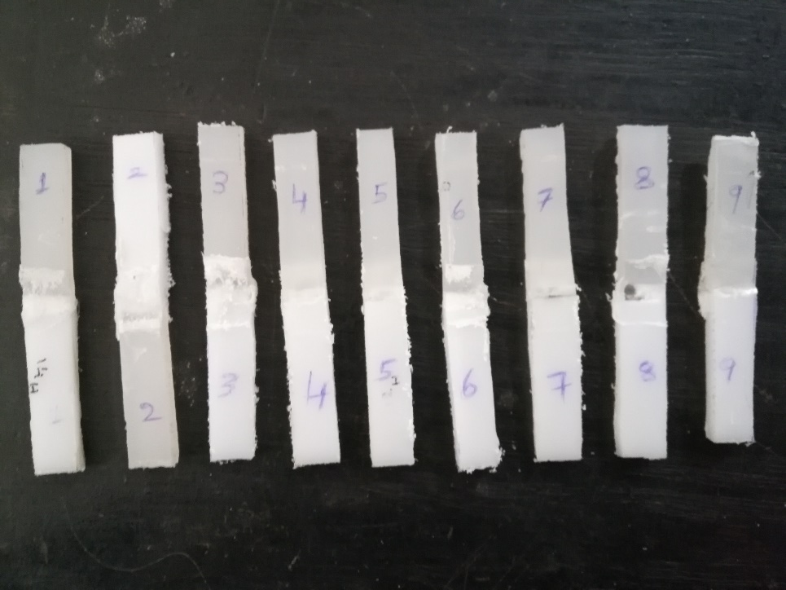
Experimentation
As per design of experimentation table (Taguchi L9 method) , we perform experiment according to that parameters on CNC milling machine.
One 9 FSW samples for Tensile test and another 9 FSW samples for for Bending test.
For Tensile strength test
For Bend strength test
Video
FSW on dissimilar polymers

Slide 19
Tensile strength test results
we perform Tensile test on UTM(Universal Testing Machine) and we get results that shown in below table
S. No. | Tool speed (rpm) A | Feed rate speed (mm/min) B | Plunge-in time (sec) C | Peak Load (Kg) | Break Load (Kg) | Elongation at Peak Load (mm) | Elongation at Break Load (mm) | Yield load (Kg) | Area (Sq.mm) | Tensile strength at peak Load(N/Sq.mm) | Tensile strength at Break Load(N/Sq.mm)
1 | 1200 | 30 | 20 | 87.7 | 8.3 | 2.44 | 4.33 | 87.7 | 427 | 2.015 | 0.191 | 2
2 | 1200 | 40 | 40 | 40.2 | 24.8 | 1.87 | 3.48 | 40.2 | 427 | 0.924 | 0.57 | 8
3 | 1200 | 50 | 60 | 67.4 | 8.1 | 2.11 | 3.23 | 67.4 | 427 | 1.548 | 0.186 | 6
4 | 1400 | 30 | 40 | 91.8 | 8.4 | 2.47 | 3.29 | 91.8 | 427 | 2.109 | 0.193 | 1
5 | 1400 | 40 | 60 | 68.8 | 8.1 | 2.08 | 3.61 | 68.8 | 427 | 1.581 | 0.186 | 5
6 | 1400 | 50 | 20 | 79.5 | 48.3 | 2.18 | 2.47 | 79.5 | 427 | 1.826 | 1.11 | 3
7 | 1600 | 30 | 60 | 15.7 | 8.3 | 0.85 | 1.27 | 15.7 | 427 | 0.361 | 0.191 | 9
8 | 1600 | 40 | 20 | 68.9 | 8.8 | 2.91 | 3.67 | 68.9 | 427 | 1.583 | 0.202 | 4
9 | 1600 | 50 | 40 | 53.3 | 8.2 | 2.43 | 3.47 | 53.3 | 427 | 1.225 | 0.188 | 7

Slide 20
Bending strength test results
we perform Bending strength test on UTM(Universal Testing Machine) and we get results that shown in below table
S. No. | Tool speed (rpm) A | Feed rate speed (mm/min) B | Plunge-in time (sec) C | Peak Load (N) | Break Load (N) | Elongation at Peak Load (mm) | Elongation at Break Load (mm) | Area (Sq.mm) | Peak Strength(Mpa) | Break Strength (Mpa) | Youngs Modulus
1 | 1200 | 30 | 20 | 5.3 | 4.77 | 0.76 | 4.75 | 50 | 1.590 | 1.431 | -263.1579
2 | 1200 | 40 | 40 | 9.7 | 8.73 | 1.33 | 3.23 | 50 | 2.910 | 2.619 | -263.1579
3 | 1200 | 50 | 60 | 11 | 9.90 | 2.28 | 9.50 | 50 | 3.300 | 2.970 | -263.1579
4 | 1400 | 30 | 40 | 5.30 | 4.77 | 0.76 | 3.04 | 50 | 1.590 | 1.431 | -263.1579
5 | 1400 | 40 | 60 | 1.10 | 0.99 | 0.57 | 7.79 | 50 | 0.330 | 0.297 | -263.1579
6 | 1400 | 50 | 20 | 3.60 | 3.24 | 0.95 | 2.85 | 50 | 1.080 | 0.972 | -263.1579
7 | 1600 | 30 | 60 | 7.50 | 6.75 | 1.14 | 5.13 | 50 | 2.250 | 2.025 | -263.1579
8 | 1600 | 40 | 20 | 2.40 | 2.16 | 0.57 | 2.66 | 50 | 0.720 | 0.648 | -263.1579
9 | 1600 | 50 | 40 | 2.00 | 1.80 | 1.71 | 7.41 | 50 | 0.600 | 0.540 | -263.1579

Slide 21
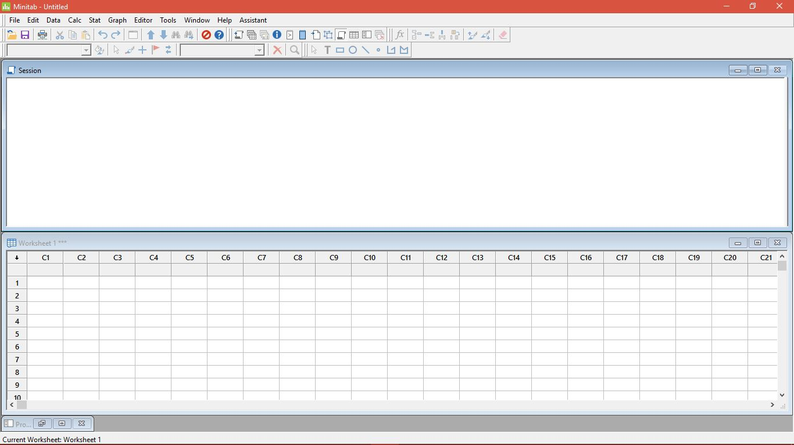
Minitab 18
we used Minitab 18 software for analysis purpose.
This software takes resultant data and gives data on S/N ratio, response table , graph on S/N ratio.

Slide 22
Analysis on minitab 18 software
Steps for analysis:
Open minitab18 software.
Go to stat
Then go to DOE
Then choose Taguchi method and create Taguchi design
In Taguchi design, we choose 3-Level Design
Number of factor: 3
Then go to design and choose L9 method and click ok
Click ok to Taguchi design.
Again go to stat >> DOE >> Taguchi method >> Define Custom Taguchi Design >> Select First three parameters >> Click Ok.
Again go to stat >> DOE >> Taguchi method >> Analyse Taguchi Design >> Select required data cell that you need to analyse >> goto Graph >> Choose S/N ratios then OK >> Analysis >> For displaying response table and for Fit linear model chosen S/N ratios then click OK >> goto Options >> select larger is better then click OK >> go to storage >> select S/N ratios then click OK >> for getting the final analysis results click OK >> then analysis table, response table and graph will be generate.

Slide 23
Analysis data
results on Tensile strength test:
Resultant data for Tensile test
S. No. | Tool speed (rpm) | Feed rate speed (mm/min) | Plunge-in time (sec) | Tensile strength at peak Load(N/Sq.mm) | S\N Ratio | Means
1 | 1200 | 30 | 20 | 2.015 | 6.08550 | 2.015
2 | 1200 | 40 | 40 | 0.924 | -0.68656 | 0.924
3 | 1200 | 50 | 60 | 1.548 | 3.79542 | 1.548
4 | 1400 | 30 | 40 | 2.109 | 6.48153 | 2.109
5 | 1400 | 40 | 60 | 1.581 | 3.97864 | 1.581
6 | 1400 | 50 | 20 | 1.826 | 5.23002 | 1.826
7 | 1600 | 30 | 60 | 0.361 | -8.84986 | 0.361
8 | 1600 | 40 | 20 | 1.583 | 3.98962 | 1.583
9 | 1600 | 50 | 40 | 1.225 | 1.76272 | 1.225
Analysis of Variance for SN ratios
Source | DF | Seq SS | Adj SS | Adj MS | F | P | Significance
Tool Speed(rpm) | 2 | 60.696 | 60.696 | 30.348 | 0.89 | 0.528 | Yes
Feed Speed(mm/min) | 2 | 8.333 | 8.333 | 4.167 | 0.12 | 0.891 | Yes
Plunge in time(sec) | 2 | 44.766 | 44.766 | 22.383 | 0.66 | 0.603 | Yes
Residual Error | 2 | 67.910 | 67.910 | 33.955
Total | 8 | 181.705

Slide 24
Analysis data
results on Tensile strength test:
Response Table for Signal to Noise Ratios- Larger is better
Level | Tool Speed(rpm) | Feed Speed(mm/min) | Plunge in time(sec)
1 | 3.0648 | 1.2391 | 5.1017
2 | 5.2301 | 2.4272 | 2.5192
3 | -1.0325 | 3.5961 | -0.3586
Delta | 6.2626 | 2.3570 | 5.4603
Rank | 1 | 3 | 2

Slide 25
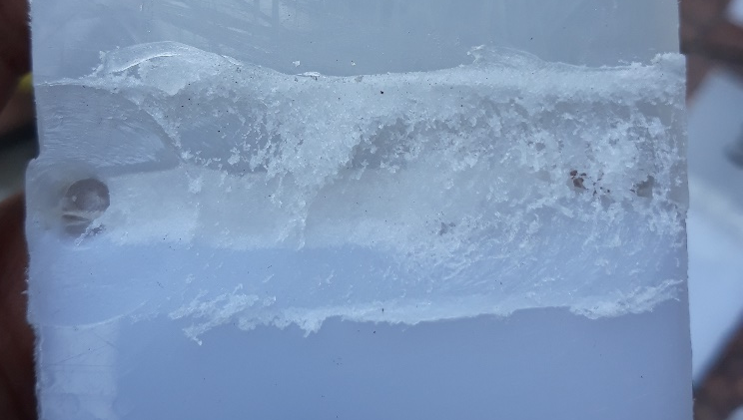
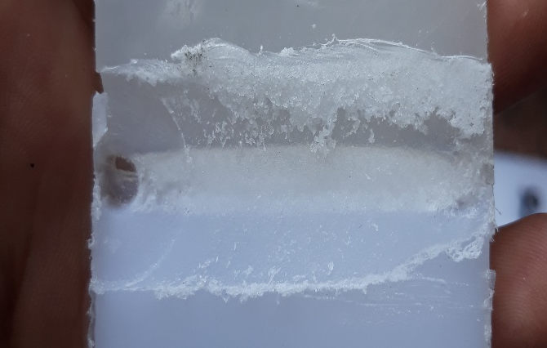
Result and discussion on tensile test
results on Tensile strength test:
Tool Speed:
In plot, It has been found that with an increase in tool speed, the tensile strength of the joint first increased, but then started to decrease when tool speed level further increased.
Decrease in tensile strength is due to high tool speed which causes pores at joint where material undergoes melting and expelling of material from the joint.
more pores and expelled material
No pores and less expelled material
Expelled Material
Pores

Slide 26
Result and discussion on tensile test
results on Tensile strength test:
Feed Speed Rate:
On increasing the feed rate speed, it is found that tensile strength of the joint is increasing. Feed rate is one of the parameter which enhances the strength of the joint.
Plunge in time:
Plunge in time is one of the important factor to make good tensile strength of the FSW welded joint.
On increasing the plunge in time the tensile strength of the joint decreases due the excessive melting of the material at the joint.
The melting of material causes expelling due to more plunge in time.
the first level parameter is optimum for good tensile strength.

Slide 27
Analysis data
results on Bending strength test:
Resultant data for Bending Strength test
S.No | Tool speed (rpm) | Feed rate speed (mm/min) | Plunge-in time (sec) | Peak Strength (Mpa) | S\N Ratios | Means
1 | 1200 | 30 | 20 | 1.590 | 4.02794 | 1.59
2 | 1200 | 40 | 40 | 2.910 | 9.27786 | 2.91
3 | 1200 | 50 | 60 | 3.300 | 10.3703 | 3.30
4 | 1400 | 30 | 40 | 1.590 | 4.02794 | 1.59
5 | 1400 | 40 | 60 | 0.330 | -9.62972 | 0.33
6 | 1400 | 50 | 20 | 1.080 | 0.668475 | 1.08
7 | 1600 | 30 | 60 | 2.250 | 7.04365 | 2.25
8 | 1600 | 40 | 20 | 0.720 | -2.85335 | 0.72
9 | 1600 | 50 | 40 | 0.600 | -4.43697 | 0.60
Analysis of Variance for SN ratios
Source | DF | Seq SS | Adj SS | Adj MS | F | P | Significance
Tool Speed | 2 | 156.973 | 156.973 | 78.487 | 1.15 | 0.465 | No
Tool Feed Rate Speed | 2 | 55.939 | 55.939 | 27.970 | 0.41 | 0.709 | Yes
Plunge in Time | 2 | 9.537 | 9.537 | 4.769 | 0.07 | 0.935 | Yes
Residual Error | 2 | 136.228 | 136.228 | 68.114
Total | 8 | 358.678

Slide 28
Analysis data
results on Bending strength test:
Response Table for Signal to Noise Ratios- Larger is better
Level | Tool Speed | Tool Feed Rate Speed | Plunge in Time
1 | 7.89203 | 5.03318 | 0.61436
2 | -1.64443 | -1.06840 | 2.95628
3 | -0.08222 | 2.20059 | 2.59474
Delta | 9.53646 | 6.10158 | 2.34192
Rank | 1 | 2 | 3

Slide 29
Result and discussion on Bending strength test
results on Tensile strength test:
Tool Speed:
On increase in tool speed, the bending strength goes on decreases up to level 2 parameter of tool speed and further increases in tool speed to level 3 parameter slightly increases bending strength.
This is because of expelling of material and causes gap at weld joint.
higher tool speeds cause easy deformation within the material.
Feed Speed Rate:
On increase in feed rate speed, bending strength decreased first and increased by increase in feed rate speed this is due to the improper pores formed due to high tool speed and plunge in time.
The resultant of these two parameters affected the bending strength of the joint irrespective of feed rate speed.

Slide 30
Result and discussion on tensile test
results on Tensile strength test:
Plunge in time:
On increase in plunge in time, the bending strength of the joint increases first and slightly decreases by further increase in plunge in time.
At level 1 parameter expelling of material is less comparatively with other two levels where as at level 2 parameter expelling of material within in the joint region is slightly increased but it increases the bending strength.
At level 3 parameter the expelling is more due to this pores are formed and These pores cause the easy deformation within the material and decreases the bending strength.

Slide 31
conclusion
Welding of dissimilar materials (Nylon-6,6 – HDPE) using FSW is made successfully achieved.
The tensile and bending tests performed on the welded joint gives the significant results for tensile test at optimum parameters is tool speed:1400, feed rate speed:30, Plunge in time: 40 and for bending strength is tool speed:1200, feed rate speed:50, plunge in time: 60.
Variation in the input parameters such as tool speed, tool feed rate and plunge in time causes expelling of material from the joint region and also decreases joint efficiency.
Joint strength at start and end point of the welded joint is less because due to plunge in time.
The morphological characterization could be done to strengthen the mechanical findings.

Slide 32
Thank you

